Slide 1
Logical Agents
Notes:
‹#›

Slide 2
Outline
Knowledge-based agents
Wumpus world
Logic in general - models and entailment
Propositional (Boolean) logic
Equivalence, validity, satisfiability
Inference rules and theorem proving
forward chaining
backward chaining
resolution
Notes:
‹#›

Slide 3

Knowledge bases
Knowledge base = set of sentences in a formal language
Declarative approach to building an agent (or other system):
Tell it what it needs to know
Then it can Ask itself what to do - answers should follow from the KB
Agents can be viewed at the knowledge level
i.e., what they know, regardless of how implemented
Or at the implementation level
i.e., data structures in KB and algorithms that manipulate them
Notes:
‹#›

Slide 4
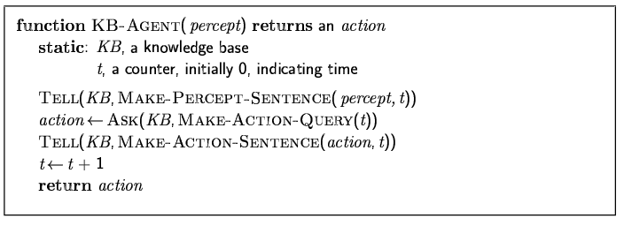
A simple knowledge-based agent
The agent must be able to:
Represent states, actions, etc.
Incorporate new percepts
Update internal representations of the world
Deduce hidden properties of the world
Deduce appropriate actions
Notes:
‹#›

Slide 5
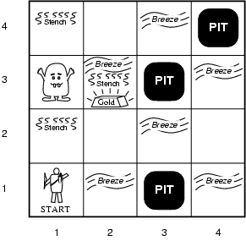
Wumpus World PEAS description
Performance measure
gold +1000, death -1000
-1 per step, -10 for using the arrow
Environment
Squares adjacent to wumpus are smelly
Squares adjacent to pit are breezy
Glitter iff gold is in the same square
Shooting kills wumpus if you are facing it
Shooting uses up the only arrow
Grabbing picks up gold if in same square
Releasing drops the gold in same square
Sensors: Stench, Breeze, Glitter, Bump, Scream
Actuators: Left turn, Right turn, Forward, Grab, Release, Shoot
Notes:
‹#›

Slide 6
Wumpus world characterization
Fully Observable No – only local perception
Deterministic Yes – outcomes exactly specified
Episodic No – sequential at the level of actions
Static Yes – Wumpus and Pits do not move
Discrete Yes
Single-agent? Yes – Wumpus is essentially a natural feature
Notes:
‹#›

Slide 7
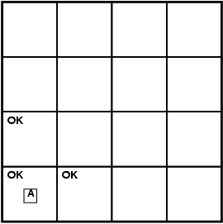
Exploring a wumpus world
Percepts:
[Stench, Breeze, Glitter, Bump, Scream]
[0,0,0,0,0]
Notes:
‹#›

Slide 8
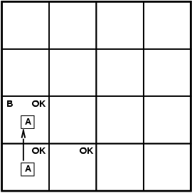
Exploring a wumpus world
Percepts:
[Stench, Breeze, Glitter, Bump, Scream]
[0,1,0,0,0]
Notes:
‹#›

Slide 9
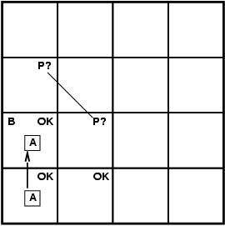
Exploring a wumpus world
Percepts:
[Stench, Breeze, Glitter, Bump, Scream]
[0,1,0,0,0]
Notes:
‹#›

Slide 10
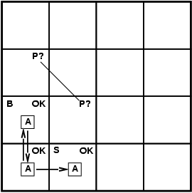
Exploring a wumpus world
Percepts:
[Stench, Breeze, Glitter, Bump, Scream]
[1,0,0,0,0]
Notes:
‹#›

Slide 11
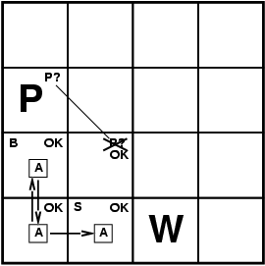
Exploring a wumpus world
Percepts:
[Stench, Breeze, Glitter, Bump, Scream]
[1,0,0,0,0]
Notes:
‹#›

Slide 12

Exploring a wumpus world
Percepts:
[Stench, Breeze, Glitter, Bump, Scream]
[0,0,0,0,0]
Notes:
‹#›

Slide 13
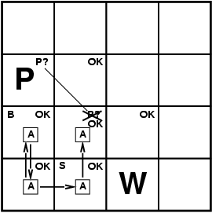
Exploring a wumpus world
Percepts:
[Stench, Breeze, Glitter, Bump, Scream]
[0,0,0,0,0]
Notes:
‹#›

Slide 14
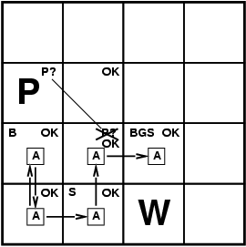
Exploring a wumpus world
Percepts:
[Stench, Breeze, Glitter, Bump, Scream]
[1,1,1,0,0]
Notes:
‹#›

Slide 15
Logic in general
Logics are formal languages for representing information such that conclusions can be drawn
Syntax defines the sentences in the language
Semantics define the "meaning" of sentences;
i.e., define truth of a sentence in a world
E.g., the language of arithmetic
x+2 ≥ y is a sentence; x2+y > {} is not a sentence
x+2 ≥ y is true iff the number x+2 is no less than the number y
x+2 ≥ y is true in a world where x = 7, y = 1
x+2 ≥ y is false in a world where x = 0, y = 6
Notes:
‹#›

Slide 16
Entailment
Entailment means that one thing follows from another:
KB ╞ α
Knowledge base KB entails sentence α if and only if α is true in all worlds where KB is true
E.g., the KB containing “the Giants won” and “the Reds won” entails “Either the Giants won or the Reds won”
E.g., x+y = 4 entails 4 = x+y
Entailment is a relationship between sentences (i.e., syntax) that is based on semantics
Notes:
‹#›

Slide 17
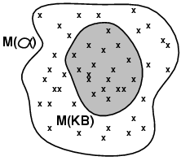
Models
Logicians typically think in terms of models, which are formally structured worlds with respect to which truth can be evaluated
We say m is a model of a sentence α if α is true in m
M(α) is the set of all models of α
Then KB ╞ α iff M(KB) ⊆ M(α)
E.g. KB = Giants won and Reds won α = Giants won
Notes:
‹#›

Slide 18
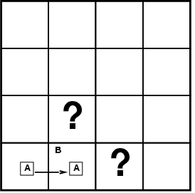
Entailment in the wumpus world
Situation after detecting nothing in [1,1], moving right, breeze in [2,1]
Consider possible models for KB assuming only pits
2 Boolean choices ⇒ 4 possible models
Notes:
‹#›

Slide 19
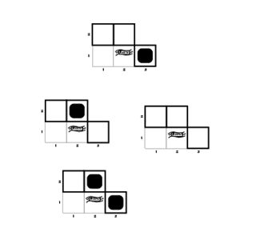
Wumpus models
Notes:
‹#›

Slide 20
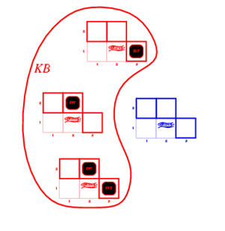
Wumpus models
KB = wumpus-world rules + observations
Notes:
‹#›

Slide 21
Inference
KB ├_{i} α = sentence α can be derived from KB by procedure i
Soundness: i is sound if whenever KB ├_{i} α, it is also true that KB╞ α
Completeness: i is complete if whenever KB╞ α, it is also true that KB ├_{i} α
Preview: we will define a logic (first-order logic) which is expressive enough to say almost anything of interest, and for which there exists a sound and complete inference procedure.
That is, the procedure will answer any question whose answer follows from what is known by the KB.
Notes:
‹#›

Slide 22
Propositional logic: Syntax
Propositional logic is the simplest logic – illustrates basic ideas
The proposition symbols P₁, P₂ etc are sentences
If S is a sentence, ¬S is a sentence (negation)
If S₁ and S₂ are sentences, S₁ ∧ S₂ is a sentence (conjunction)
If S₁ and S₂ are sentences, S₁ ∨ S₂ is a sentence (disjunction)
If S₁ and S₂ are sentences, S₁ ⇒ S₂ is a sentence (implication)
If S₁ and S₂ are sentences, S₁ ⇔ S₂ is a sentence (biconditional)
Notes:
‹#›

Slide 23
Propositional logic
Logical constants: true, false
Propositional symbols: P, Q, S, ... (atomic sentences)
Wrapping parentheses: ( … )
Sentences are combined by connectives:
∧ ...and [conjunction]
∨ ...or [disjunction]
⇒...implies [implication / conditional]
⇔..is equivalent [biconditional]
¬ ...not [negation]
Literal: atomic sentence or negated atomic sentence
P, ¬ P
‹#›
Notes:
‹#›
‹#›

Slide 24
Examples of PL sentences
(P ∧ Q) → R
“If it is hot and humid, then it is raining”
Q → P
“If it is humid, then it is hot”
Q
“It is humid.”
A better way:
Ho = “It is hot”
Hu = “It is humid”
R = “It is raining”
‹#›
Notes:
‹#›
‹#›

Slide 25
Propositional logic: Semantics
Each model specifies true/false for each proposition symbol
E.g. P_{1,2} P_{2,2} P_{3,1}
false true false
With these symbols, 8 possible models, can be enumerated automatically.
Rules for evaluating truth with respect to a model m:
¬S is true iff S is false
S₁ ∧ S₂ is true iff S₁ is true and S₂ is true
S₁ ∨ S₂ is true iff S₁is true or S₂ is true
S₁ ⇒ S₂ is true iff S₁ is false or S₂ is true
is false iff S₁ is true and S₂ is false
S₁ ⇔ S₂ is true iff S₁⇒S₂ is true and S₂⇒S₁ is true
Simple recursive process evaluates an arbitrary sentence, e.g.,
¬P_{1,2} ∧ (P_{2,2} ∨ P_{3,1}) = true ∧ (true ∨ false) = true ∧ true = true
Notes:
‹#›

Slide 26


Truth tables II
The five logical connectives:
A complex sentence:
‹#›
Notes:
‹#›
‹#›

Slide 27
Wumpus world sentences
Let P_{i,j} be true if there is a pit in [i, j].
Let B_{i,j} be true if there is a breeze in [i, j].
¬ P_{1,1}
¬B_{1,1}
B_{2,1}
"Pits cause breezes in adjacent squares"
B_{1,1} ⇔ (P_{1,2} ∨ P_{2,1})
B_{2,1} ⇔ (P_{1,1} ∨ P_{2,2} ∨ P_{3,1})
Notes:
‹#›

Slide 28
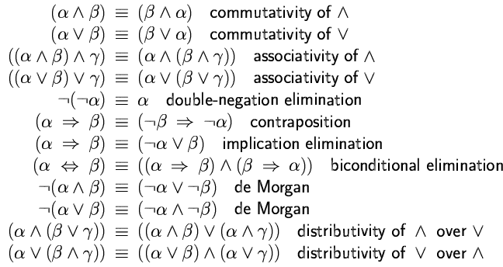
Logical equivalence
Two sentences are logically equivalent iff true in same models: α ≡ ß iff α╞ β and β╞ α
Notes:
‹#›

Slide 29
Validity and satisfiability
A sentence is valid if it is true in all models,
e.g., True, A ∨¬A, A ⇒ A, (A ∧ (A ⇒ B)) ⇒ B
Validity is connected to inference via the Deduction Theorem:
KB ╞ α if and only if (KB ⇒ α) is valid
A sentence is satisfiable if it is true in some model
e.g., A∨ B, C
A sentence is unsatisfiable if it is true in no models
e.g., A∧¬A
Satisfiability is connected to inference via the following:
KB ╞ α if and only if (KB ∧¬α) is unsatisfiable
Notes:
‹#›

Slide 30
Sound rules of inference
Here are some examples of sound rules of inference
A rule is sound if its conclusion is true whenever the premise is true
Each can be shown to be sound using a truth table
RULE PREMISE CONCLUSION
Modus Ponens A, A → B B
And Introduction A, B A ∧ B
And Elimination A ∧ B A
Double Negation ¬¬A A
Unit Resolution A ∨ B, ¬B A
Resolution A ∨ B, ¬B ∨ C A ∨ C
‹#›
Notes:
‹#›
‹#›

Slide 31
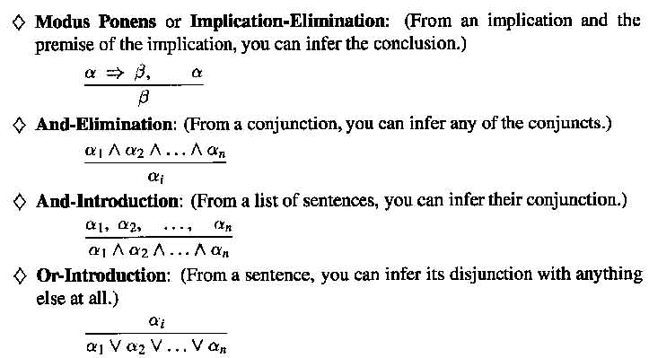
Inference Rules
‹#›
Notes:
‹#›

Slide 32
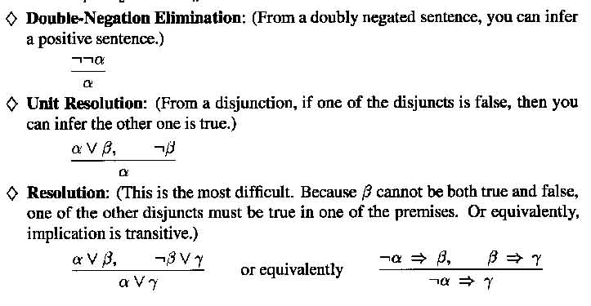
Inference Rules
‹#›
Notes:
‹#›

Slide 33
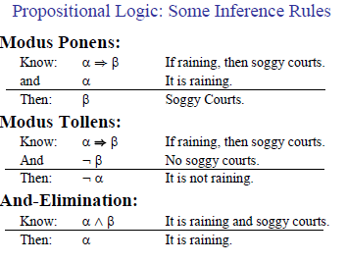
‹#›
Notes:
‹#›

Slide 34
Proving things
A proof is a sequence of sentences, where each sentence is either a premise or a sentence derived from earlier sentences in the proof by one of the rules of inference.
The last sentence is the theorem (also called goal or query) that we want to prove.
Example for the “weather problem”.
1 Hu Premise “It is humid”
2 Hu→Ho Premise “If it is humid, it is hot”
3 Ho Modus Ponens(1,2) “It is hot”
4 (Ho∧Hu)→R Premise “If it’s hot & humid, it’s raining”
5 Ho∧Hu And Introduction(1,3) “It is hot and humid”
6 R Modus Ponens(4,5) “It is raining”
‹#›
Notes:
‹#›
‹#›

Slide 35
Problems with Propositional Logic
‹#›
Notes:
‹#›
‹#›

Slide 36
Propositional logic is a weak language
Hard to identify “individuals” (e.g., Mary, 3)
Can’t directly talk about properties of individuals or relations between individuals (e.g., “Bill is tall”)
Generalizations, patterns, regularities can’t easily be represented (e.g., “all triangles have 3 sides”)
First-Order Logic (abbreviated FOL) is expressive enough to concisely represent this kind of information
FOL adds relations, variables, and quantifiers, e.g.,
“Every elephant is gray”: ∀ x (elephant(x) → gray(x))
“There is a white alligator”: ∃ x (alligator(X) ^ white(X))
‹#›
Notes:
‹#›
‹#›

Slide 37
Example
Consider the problem of representing the following information:
Every person is mortal.
John is a person.
John is mortal.
How can these sentences be represented so that we can infer the third sentence from the first two?
‹#›
Notes:
‹#›
‹#›

Slide 38
Example II
In PL we have to create propositional symbols to stand for all or part of each sentence. For example, we might have:
P = “person”; Q = “mortal”; R = “John”
so the above 3 sentences are represented as:
P → Q; R → P; R → Q
Although the third sentence is entailed by the first two, we needed an explicit symbol, R, to represent an individual, John, who is a member of the classes “person” and “mortal”
To represent other individuals we must introduce separate symbols for each one, with some way to represent the fact that all individuals who are “people” are also “mortal”
‹#›
Notes:
‹#›
‹#›

Slide 39
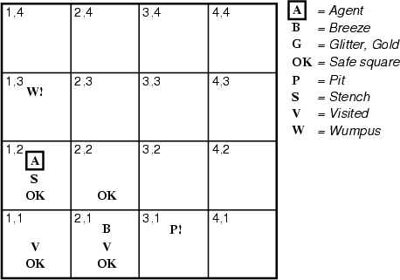
The “Hunt the Wumpus” agent
Some atomic propositions:
S12 = There is a stench in cell (1,2)
B21 = There is a breeze in cell (2,1)
W13 = The Wumpus is in cell (1,3)
V11 = We have visited cell (1,1)
OK11 = Cell (1,1) is safe.
etc
Some rules:
(R1) ¬S11 → ¬W11 ∧ ¬ W12 ∧ ¬ W21
(R2) ¬ S21 → ¬W11 ∧ ¬ W21 ∧ ¬ W22 ∧ ¬ W31
…………….
(R4) S12 → W13 ∨ W12 ∨ W22 ∨ W11
Etc.
Note that the lack of variables requires us to give similar rules for each cell
‹#›
Notes:
‹#›
‹#›

Slide 40
After the third move
We can prove that the Wumpus is in (1,3) using the four rules given.
‹#›
Notes:
‹#›
‹#›

Slide 41
Proving W13
(R1) ¬S11 → ¬W11 ∧ ¬ W12 ∧ ¬ W21
Apply MP with ¬S11 and R1:
¬ W11 ∧ ¬ W12 ∧ ¬ W21
Apply And-Elimination to this, yielding 3 sentences:
W11, ¬ W12, ¬ W21
(R2) ¬ S21 → ¬W11 ∧ ¬ W21 ∧ ¬ W22 ∧ ¬ W31
Apply MP to ¬ S21 and R2, then apply And-elimination:
W22, ¬ W21, ¬ W31
(R4) S12 → W13 ∨ W12 ∨ W22 ∨ W11
Apply MP to S12 and R4 to obtain:
W13 ∨ W12 ∨ W22 ∨ W11
Apply Unit resolution on (W13 ∨ W12 ∨ W22 ∨ W11) and ¬W11:
W13 ∨ W12 ∨ W22
Apply Unit Resolution with (W13 ∨ W12 ∨ W22) and ¬W22:
W13 ∨ W12
Apply UR with (W13 ∨ W12) and ¬W12:
W13
‹#›
Notes:
‹#›
‹#›

Slide 42
Problems with the propositional Wumpus hunter
Lack of variables prevents stating more general rules
We need a set of similar rules for each cell
Change of the KB over time is difficult to represent
This means we have a separate KB for every time point
‹#›
Notes:
‹#›
‹#›

Slide 43
First-Order Logic: Review
‹#›
Notes:
‹#›
‹#›

Slide 44
First-order logic
First-order logic (FOL) models the world in terms of
Objects, which are things with individual identities
Properties of objects that distinguish them from other objects
Relations that hold among sets of objects
Functions, which are a subset of relations where there is only one “value” for any given “input”
Examples:
Objects: Students, lectures, companies, cars ...
Relations: Brother-of, bigger-than, outside, part-of, has-color, occurs-after, owns, visits, precedes, ...
Properties: blue, oval, even, large, ...
Functions: father-of, second-half, one-more-than ...
‹#›
Notes:
‹#›
‹#›

Slide 45
First-order logic
One plus two equals three
Objects: one, two, three, one plus two
Relation: equals
Function: plus
Square neighboring the wumpus are smelly
Objects: square, wumpus
Relation: neighboring
Property: smelly
Evil King John ruled England in 1200
Objects: John, England, 1200
Relation: ruled
Property: evil, King
Notes:
‹#›

Slide 46
User provides
Constant symbols, which represent individuals in the world
Mary
3
Green
Function symbols, which map individuals to individuals
father-of(Mary) = John
color-of(Sky) = Blue
Predicate symbols, which map individuals to truth values
greater(5,3)
green(Grass)
color(Grass, Green)
‹#›
Notes:
‹#›
‹#›

Slide 47
FOL Provides
Variable symbols
E.g., x, y, foo
Connectives
Same as in PL: not (¬), and (∧), or (∨), implies (→), if and only if (biconditional ↔)
Quantifiers
Universal ∀x
Existential ∃x
‹#›
Notes:
‹#›
‹#›

Slide 48
Sentences are built from terms and atoms
A term (denoting a real-world individual) is a constant symbol, a variable symbol, or an n-place function of n terms.
x and f(x₁, ..., x_{n}) are terms, where each x_{i} is a term.
A term with no variables is a ground term
An atomic sentence (which has value true or false) is an n-place predicate of n terms
A complex sentence is formed from atomic sentences connected by the logical connectives:
¬P, P∨Q, P∧Q, P→Q, P↔Q where P and Q are sentences
A quantified sentence adds quantifiers ∀ and ∃
A well-formed formula (wff) is a sentence containing no “free” variables. That is, all variables are “bound” by universal or existential quantifiers.
(∀x)P(x,y) has x bound as a universally quantified variable, but y is free.
‹#›
Notes:
‹#›
‹#›

Slide 49
Quantifiers
Universal quantification
(∀x)P(x) means that P holds for all values of x in the domain associated with that variable
E.g., (∀x) dolphin(x) → mammal(x)
Existential quantification
(∃ x)P(x) means that P holds for some value of x in the domain associated with that variable
E.g., (∃ x) mammal(x) ∧ lays-eggs(x)
Permits one to make a statement about some object without naming it
‹#›
Notes:
‹#›
‹#›

Slide 50
Quantifiers
Universal quantifiers are often used with “implies” to form “rules”:
(∀x) student(x) → smart(x) means “All students are smart”
Universal quantification is rarely used to make blanket statements about every individual in the world:
(∀x)student(x)∧smart(x) means “Everyone in the world is a student and is smart”
Existential quantifiers are usually used with “and” to specify a list of properties about an individual:
(∃x) student(x) ∧ smart(x) means “There is a student who is smart”
‹#›
Notes:
‹#›
‹#›

Slide 51
Quantifier Scope
FOL sentences have structure, like programs
In particular, the variables in a sentence have a scope
For example, suppose we want to say
“everyone who is alive loves someone”
(∀x) alive(x) → (∃y) loves(x,y)
Here’s how we scope the variables
(∀x) alive(x) → (∃y) loves(x,y)
Scope of x
Scope of y
‹#›
Notes:
‹#›
‹#›

Slide 52
Quantifier Scope
Switching the order of universal quantifiers does not change the meaning:
(∀x)(∀y)P(x,y) ↔ (∀y)(∀x) P(x,y)
“Dogs hate cats”.
Similarly, you can switch the order of existential quantifiers:
(∃x)(∃y)P(x,y) ↔ (∃y)(∃x) P(x,y)
“A cat killed a dog”
Switching the order of universals and existentials does change meaning:
Everyone likes someone: (∀x)(∃y) likes(x,y)
Someone is liked by everyone: (∃y)(∀x) likes(x,y)
‹#›
Notes:
‹#›
‹#›

Slide 53
Connections between All and Exists
We can relate sentences involving ∀ and ∃ using De Morgan’s laws:
(∀x) ¬P(x) ↔ ¬(∃x) P(x)
¬(∀x) P ↔ (∃x) ¬P(x)
(∀x) P(x) ↔ ¬ (∃x) ¬P(x)
(∃x) P(x) ↔ ¬(∀x) ¬P(x)
Examples
All dogs don’t like cats ↔ No dog’s like cats
Not all dogs dance ↔ There is a dog that doesn’t dance.
All dogs sleep ↔ There is no dog that doesn’t sleep
There is a dog that talks ↔ Not all dogs can’t talk
‹#›
Notes:
‹#›
‹#›

Slide 54
Quantified inference rules
Universal instantiation
∀x P(x) ∴ P(A)
Universal generalization
P(A) ∧ P(B) … ∴ ∀x P(x)
Existential instantiation
∃x P(x) ∴P(F) ← skolem constant F
Existential generalization
P(A) ∴ ∃x P(x)
‹#›
Notes:
‹#›
‹#›

Slide 55
Universal instantiation (a.k.a. universal elimination)
If (∀x) P(x) is true, then P(C) is true, where C is any constant in the domain of x
Example:
(∀x) eats(Ziggy, x) ⇒ eats(Ziggy, IceCream)
The variable symbol can be replaced by any ground term, i.e., any constant symbol or function symbol applied to ground terms only
‹#›
Notes:
‹#›
‹#›

Slide 56
Existential instantiation (a.k.a. existential elimination)
From (∃x) P(x) infer P(c)
Example:
(∃x) eats(Ziggy, x) → eats(Ziggy, Stuff)
Note that the variable is replaced by a brand-new constant not occurring in this or any other sentence in the KB
Also known as skolemization; constant is a skolem constant
In other words, we don’t want to accidentally draw other inferences about it by introducing the constant
Convenient to use this to reason about the unknown object, rather than constantly manipulating the existential quantifier
‹#›
Notes:
‹#›
‹#›

Slide 57
Existential generalization (a.k.a. existential introduction)
If P(c) is true, then (∃x) P(x) is inferred.
Example
eats(Ziggy, IceCream) ⇒ (∃x) eats(Ziggy, x)
All instances of the given constant symbol are replaced by the new variable symbol
Note that the variable symbol cannot already exist anywhere in the expression
‹#›
Notes:
‹#›
‹#›

Slide 58
Translating English to FOL
Every gardener likes the sun.
∀x gardener(x) → likes(x,Sun)
You can fool some of the people all of the time.
∃x ∀t person(x) ∧time(t) → can-fool(x,t)
You can fool all of the people some of the time. (two ways)
∀x ∃t (person(x) → time(t) ∧can-fool(x,t))
∀x (person(x) → ∃t (time(t) ∧can-fool(x,t))
All purple mushrooms are poisonous.
∀x (mushroom(x) ∧ purple(x)) → poisonous(x)
‹#›
Notes:
‹#›
‹#›

Slide 59
Translating English to FOL
No purple mushroom is poisonous. (two ways)
¬∃x purple(x) ∧ mushroom(x) ∧ poisonous(x)
∀x (mushroom(x) ∧ purple(x)) → ¬poisonous(x)
There are exactly two purple mushrooms.
∃x ∃y mushroom(x) ∧ purple(x) ∧ mushroom(y) ∧ purple(y) ^ ¬(x=y) ∧ ∀z (mushroom(z) ∧ purple(z)) → ((x=z) ∨ (y=z))
Bush is not tall.
¬tall(Bush)
X is above Y iff X is on directly on top of Y or there is a pile of one or more other objects directly on top of one another starting with X and ending with Y.
∀x ∀y above(x,y) ↔ (on(x,y) ∨ ∃z (on(x,z) ∧ above(z,y)))
‹#›
Notes:
‹#›
‹#›

Slide 60
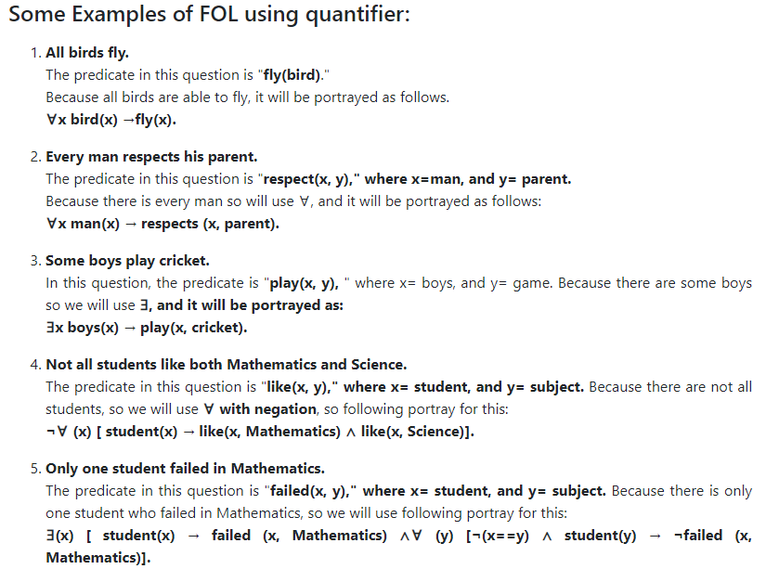

Slide 61
All students are smart.
∀ x ( Student(x) ⇒ Smart(x) )
There exists a student.
∃ x Student(x).
There exists a smart student.
∃ x ( Student(x) ∧ Smart(x) )
Every student loves some student.
∀ x ( Student(x) ⇒∃ y ( Student(y) ∧ Loves(x,y) ))
Every student loves some other student.
∀ x ( Student(x) ⇒∃ y ( Student(y) ∧¬ (x = y) ∧ Loves(x,y) ))
There is a student who is loved by every other student.
∃ x ( Student(x) ∧∀ y ( Student(y) ∧¬(x = y) ⇒ Loves(y,x) ))
Bill is a student.
Student(Bill)
Bill takes either Analysis or Geometry (but not both)
Takes(Bill, Analysis) ⇔¬ Takes(Bill, Geometry)

Slide 62
Bill takes Analysis or Geometry (or both).
Takes(Bill, Analysis) ∨ Takes(Bill, Geometry)
Bill takes Analysis and Geometry.
Takes(Bill, Analysis) ∧ Takes(Bill, Geometry)
Bill does not take Analysis.
¬Takes(Bill, Analysis).
No student loves Bill.
¬∃ x ( Student(x) ∧ Loves(x, Bill) )
Bill has at least one sister.
∃ x SisterOf(x,Bill)
Bill has no sister.
¬∃ x SisterOf(x,Bill)
Bill has at most one sister.
∀ x, y ( SisterOf(x, Bill) ∧ SisterOf(y, Bill) ⇒ x = y )

Slide 63
Bill has exactly one sister.
∃ x ( SisterOf(x, Bill) ∧∀y ( SisterOf(y, Bill) ⇒ x = y ))
Bill has at least two sisters.
∃ x, y ( SisterOf(x, Bill) ∧ SisterOf(y, Bill) ∧¬ (x = y) )
Every student takes at least one course.
∀ x ( Student(x) ⇒∃ y ( Course(y) ∧ Takes(x,y) ))
Only one student failed History.
∃ x ( Student(x) ∧ Failed(x, History) ∧∀y ( Student(y) ∧ Failed(y, History) ⇒ x = y ))
Only one student failed History.
∃ x ( Student(x) ∧ Failed(x, History) ∧∀y ( Student(y) ∧ Failed(y, History) ⇒ x = y ))
No student failed Chemistry but at least one student failed History.
¬∃ x ( Student(x) ∧ Failed(x, Chemistry) ) ∧∃ x ( Student(x) ∧ Failed(x, History) )
Every student who takes Analysis also takes Geometry.
∀ x ( Student(x) ∧ Takes(x, Analysis) ⇒ Takes(x, Geometry) )
No student can fool all the other students.
¬∃ x ( Student(x) ∧∀ y ( Student(y) ∧¬ (x = y) ⇒ Fools(x,y) ))

Slide 64
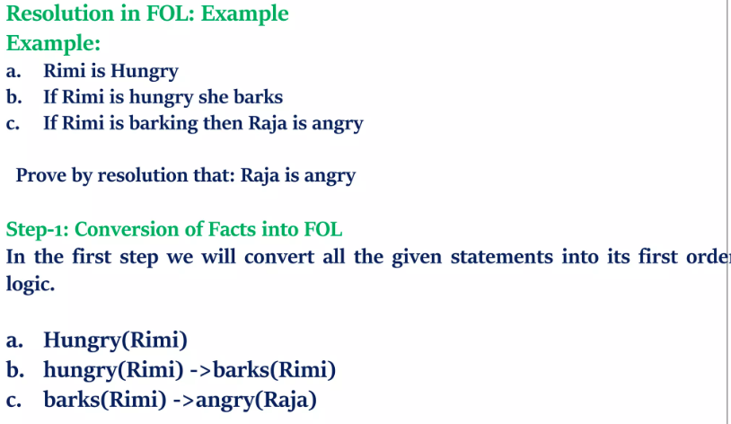

Slide 65
Example: A simple genealogy KB by FOL
Build a small genealogy knowledge base using FOL that
contains facts of immediate family relations (spouses, parents, etc.)
contains definitions of more complex relations (ancestors, relatives)
is able to answer queries about relationships between people
Predicates:
parent(x, y), child(x, y), father(x, y), daughter(x, y), etc.
spouse(x, y), husband(x, y), wife(x,y)
ancestor(x, y), descendant(x, y)
male(x), female(y)
relative(x, y)
Facts:
husband(Joe, Mary), son(Fred, Joe)
spouse(John, Nancy), male(John), son(Mark, Nancy)
father(Jack, Nancy), daughter(Linda, Jack)
daughter(Liz, Linda)
etc.
‹#›
Notes:
‹#›
‹#›

Slide 66
Rules for genealogical relations
(∀x,y) parent(x, y) ↔ child (y, x)
(∀x,y) father(x, y) ↔ parent(x, y) ∧ male(x) (similarly for mother(x, y))
(∀x,y) daughter(x, y) ↔ child(x, y) ∧ female(x) (similarly for son(x, y))
(∀x,y) husband(x, y) ↔ spouse(x, y) ∧ male(x) (similarly for wife(x, y))
(∀x,y) spouse(x, y) ↔ spouse(y, x) (spouse relation is symmetric)
(∀x,y) parent(x, y) → ancestor(x, y)
(∀x,y)(∃z) parent(x, z) ∧ ancestor(z, y) → ancestor(x, y)
(∀x,y) descendant(x, y) ↔ ancestor(y, x)
(∀x,y)(∃z) ancestor(z, x) ∧ ancestor(z, y) → relative(x, y)
(related by common ancestry)
(∀x,y) spouse(x, y) → relative(x, y) (related by marriage)
(∀x,y)(∃z) relative(z, x) ∧ relative(z, y) → relative(x, y) (transitive)
(∀x,y) relative(x, y) ↔ relative(y, x) (symmetric)
Queries
ancestor(Jack, Fred) /* the answer is yes */
relative(Liz, Joe) /* the answer is yes */
‹#›
Notes:
‹#›
‹#›

Slide 67
An example of E.I.
b1
b2
b3
b1
b2
b3
T1
T2
∀x(Bottle(x,T1) → Upturned(x, T2))
∀x∀y(Upturned(x, y) → Empty(x, y))
∀x(Full(x, T1) & Empty(x, T2) → Wet(Floor))
∃x (Bottle(x, T1) & Full(x, T1))
‹#›
Notes:
‹#›

Slide 68
An example of E.I.
Bottle(b1, T1) & Full(b1, T1)) - EI assumption
Bottle(b1, T1) - & , 5
Full(b1, T1) - & , 5
Upturned (b1, T2) - ∀ , 1 , - → , 6
Empty(b1, T2) - ∀ , 2 , - → , 7
Full(b1, T1) & Empty (b1, T2) + & , 7, 9
Wet(Floor) - ∀ , 3, - → , 10
Wet(Floor) - EI conclusion
‹#›
Notes:
‹#›

Slide 69
Outline
Reducing first-order inference to propositional inference
Unification
Generalized Modus Ponens
Forward chaining
Backward chaining
Resolution
Notes:
‹#›

Slide 70
Quantified inference rules
Universal instantiation
∀x P(x) ∴ P(A)
Universal generalization
P(A) ∧ P(B) … ∴ ∀x P(x)
Existential instantiation
∃x P(x) ∴P(F) ← skolem constant F
Existential generalization
P(A) ∴ ∃x P(x)
‹#›
Notes:
‹#›
‹#›
‹#›

Slide 71
Universal instantiation (UI)
Every instantiation of a universally quantified sentence is entailed by it:
∀v α Subst({v/g}, α)
for any variable v and ground term g
E.g., ∀x King(x) ∧ Greedy(x) ⇒ Evil(x) yields:
King(John) ∧ Greedy(John) ⇒ Evil(John)
King(Richard) ∧ Greedy(Richard) ⇒ Evil(Richard)
King(Father(John)) ∧ Greedy(Father(John)) ⇒ Evil(Father(John))
.
.
Notes:
‹#›

Slide 72
Existential instantiation (EI)
For any sentence α, variable v, and constant symbol k that does not appear elsewhere in the knowledge base:
∃v α
Subst({v/k}, α)
E.g., ∃x Crown(x) ∧ OnHead(x,John) yields:
Crown(C₁) ∧ OnHead(C₁,John)
provided C₁ is a new constant symbol, called a Skolem constant
Notes:
‹#›

Slide 73
Existential generalization (Existential introduction)
If P(c) is true, then (∃x) P(x) is inferred.
Example
eats(Ziggy, IceCream) ⇒ (∃x) eats(Ziggy, x)
All instances of the given constant symbol are replaced by the new variable symbol
Note that the variable symbol cannot already exist anywhere in the expression
‹#›
Notes:
‹#›
‹#›
‹#›

Slide 74
Reduction to propositional inference
Suppose the KB contains just the following:
∀x King(x) ∧ Greedy(x) ⇒ Evil(x)
King(John)
Greedy(John)
Brother(Richard,John)
Instantiating the universal sentence in all possible ways, we have:
King(John) ∧ Greedy(John) ⇒ Evil(John)
King(Richard) ∧ Greedy(Richard) ⇒ Evil(Richard)
King(John)
Greedy(John)
Brother(Richard,John)
The new KB is propositionalised: proposition symbols are
King(John), Greedy(John), Evil(John), King(Richard), etc.
Notes:
‹#›

Slide 75
…Reduction
Every first order KB can be propositionalised so as to preserve entailment
( “ground sentences” are entailed by new KB iff entailed by original KB)
A ground sentence is one with no variables
Idea:
propositionalise the KB
ask a query
apply resolution
return the result
Problem:
with function symbols, there are infinitely many ground terms,
Father(Father(Father(John)))
Notes:
‹#›

Slide 76
Problems with propositionalisation
Propositionalisation generates many irrelevant-seeming sentences.
E.g., from:
∀x King(x) ∧ Greedy(x) ⇒ Evil(x)
King(John)
∀y Greedy(y)
Brother(Richard,John)
it seems obvious that Evil(John), but propositionalisation produces lots of facts such as Greedy(Richard) that seem irrelevant
With p k-ary predicates and n constants, there are p·n^{k} instantiations.
Notes:
‹#›

Slide 77
Unification
if we can find a substitution θ such that King(x) and Greedy(x) match King(John) and Greedy(y)
We don’t need to generate all these irrelevant instances
We can generate the inference immediately
θ = {x/John,y/John} does this
In general,
Unify(α,β) = θ if αθ = βθ
p q θ
Knows(John,x) Knows(John,Jane)
Knows(John,x) Knows(y,OJ)
Knows(John,x) Knows(y,Mother(y))
Knows(John,x) Knows(x,OJ)
Standardizing apart eliminates overlap of variables, e.g., Knows(z₁₇,OJ)
Notes:
‹#›

Slide 78
Unification
if we can find a substitution θ such that King(x) and Greedy(x) match King(John) and Greedy(y)
We don’t need to generate all these irrelevant instances
We can generate the inference immediately
θ = {x/John,y/John} does this
In general,
Unify(α,β) = θ if αθ = βθ
p q θ
Knows(John,x) Knows(John,Jane) {x/Jane}
Knows(John,x) Knows(y,OJ)
Knows(John,x) Knows(y,Mother(y))
Knows(John,x) Knows(x,OJ)
Standardizing apart eliminates overlap of variables, e.g., Knows(z₁₇,OJ)
Notes:
‹#›

Slide 79
Unification
if we can find a substitution θ such that King(x) and Greedy(x) match King(John) and Greedy(y)
We don’t need to generate all these irrelevant instances
We can generate the inference immediately
θ = {x/John,y/John} does this
In general,
Unify(α,β) = θ if αθ = βθ
p q θ
Knows(John,x) Knows(John,Jane) {x/Jane}
Knows(John,x) Knows(y,OJ) {x/OJ, y/John}
Knows(John,x) Knows(y,Mother(y))
Knows(John,x) Knows(x,OJ)
Standardizing apart eliminates overlap of variables, e.g., Knows(z₁₇,OJ)
Notes:
‹#›

Slide 80
Unification
if we can find a substitution θ such that King(x) and Greedy(x) match King(John) and Greedy(y)
We don’t need to generate all these irrelevant instances
We can generate the inference immediately
θ = {x/John,y/John} does this
In general,
Unify(α,β) = θ if αθ = βθ
p q θ
Knows(John,x) Knows(John,Jane) {x/Jane}
Knows(John,x) Knows(y,OJ) {x/OJ, y/John}
Knows(John,x) Knows(y,Mother(y)) {x/Mother(John), y/John}
Knows(John,x) Knows(x,OJ)
Standardizing apart eliminates overlap of variables, e.g., Knows(z₁₇,OJ)
Notes:
‹#›

Slide 81
Unification
if we can find a substitution θ such that King(x) and Greedy(x) match King(John) and Greedy(y)
We don’t need to generate all these irrelevant instances
We can generate the inference immediately
θ = {x/John,y/John} does this
In general,
Unify(α,β) = θ if αθ = βθ
p q θ
Knows(John,x) Knows(John,Jane) {x/Jane}
Knows(John,x) Knows(y,OJ) {x/OJ, y/John}
Knows(John,x) Knows(y,Mother(y)) {x/Mother(John), y/John}
Knows(John,x) Knows(x,OJ) {fail}
Standardizing apart eliminates overlap of variables, e.g., Knows(z₁₇,OJ)
Notes:
‹#›

Slide 82
Generalized Modus Ponens (GMP)
p₁', p₂', … , p_{n}', ( p₁ ∧ p₂ ∧ … ∧ p_{n} ⇒q)
qθ
Example:
p₁' is King(John) p₁ is King(x)
p₂' is Greedy(y) p₂ is Greedy(x)
θ is {x/John,y/John} q is Evil(x)
q θ is Evil(John)
GMP is used with KBs of definite clauses
exactly one positive literal
All variables assumed universally quantified
Θ is chosen so that
p_{i}'θ = p_{i} θ for all i
Notes:
‹#›

Slide 83
Example knowledge base
The law says that it is a crime for an American to sell weapons to hostile nations.
The country Nono, an enemy of America, has some missiles.
All of its missiles were sold to it by Colonel West, who is American.
Prove that Col. West is a criminal
Notes:
‹#›

Slide 84
…Example knowledge base
... it is a crime for an American to sell weapons to hostile nations:
American(x) ∧ Weapon(y) ∧ Sells(x,y,z) ∧ Hostile(z) ⇒ Criminal(x)
Nono … has some missiles, i.e., ∃x Owns(Nono,x) ∧ Missile(x):
Owns(Nono,M₁) and Missile(M₁)
… all of its missiles were sold to it by Colonel West
Missile(x) ∧ Owns(Nono,x) ⇒ Sells(West,x,Nono)
Missiles are weapons:
Missile(x) ⇒ Weapon(x)
An enemy of America counts as "hostile“:
Enemy(x,America) ⇒ Hostile(x)
West, who is American …
American(West)
The country Nono, an enemy of America …
Enemy(Nono,America)
Notes:
‹#›
‹#›
American(x) ∧ Weapon(y) ∧ Sells(x,y,z) ∧ Hostile(z) ⇒ Criminal(x)
Owns(Nono,M₁) and Missile(M₁)
Missile(x) ∧ Owns(Nono,x) ⇒ Sells(West,x,Nono)
Missile(x) ⇒ Weapon(x)
Enemy(x,America) ⇒ Hostile(x)
American(West)
Enemy(Nono,America)

Slide 85
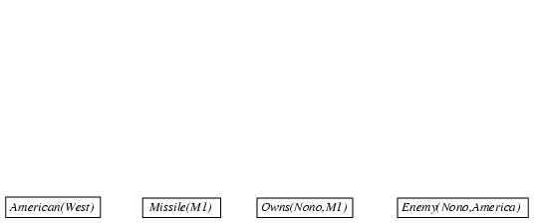
Forward chaining proof
1. American(x) ∧ Weapon(y) ∧ Sells(x,y,z) ∧ Hostile(z) ⇒ Criminal(x)
2. Owns(Nono,M1) and Missile(M1)
3. Missile(x) ∧ Owns(Nono,x) ⇒ Sells(West,x,Nono)
4. Missile(x) ⇒ Weapon(x)
5. Enemy(x,America) ⇒ Hostile(x)
6. American(West)
7. Enemy(Nono,America)
Notes:
‹#›
‹#›
American(x) ∧ Weapon(y) ∧ Sells(x,y,z) ∧ Hostile(z) ⇒ Criminal(x)
Owns(Nono,M₁) and Missile(M₁)
Missile(x) ∧ Owns(Nono,x) ⇒ Sells(West,x,Nono)
Missile(x) ⇒ Weapon(x)
Enemy(x,America) ⇒ Hostile(x)
American(West)
Enemy(Nono,America)

Slide 86
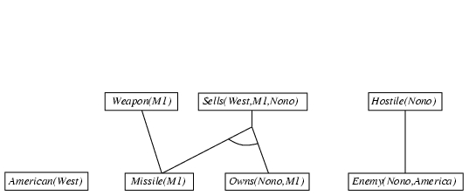
Forward chaining proof
1. American(x) ∧ Weapon(y) ∧ Sells(x,y,z) ∧ Hostile(z) ⇒ Criminal(x)
2. Owns(Nono,M1) and Missile(M1)
3. Missile(x) ∧ Owns(Nono,x) ⇒ Sells(West,x,Nono)
4. Missile(x) ⇒ Weapon(x)
5. Enemy(x,America) ⇒ Hostile(x)
6. American(West)
7. Enemy(Nono,America)
Notes:
‹#›

Slide 87
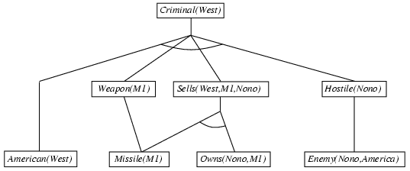
Forward chaining proof
1. American(x) ∧ Weapon(y) ∧ Sells(x,y,z) ∧ Hostile(z) ⇒ Criminal(x)
2. Owns(Nono,M1) and Missile(M1)
3. Missile(x) ∧ Owns(Nono,x) ⇒ Sells(West,x,Nono)
4. Missile(x) ⇒ Weapon(x)
5. Enemy(x,America) ⇒ Hostile(x)
6. American(West)
7. Enemy(Nono,America)
Notes:
‹#›

Slide 88

Backward chaining example
1. American(x) ∧ Weapon(y) ∧ Sells(x,y,z) ∧ Hostile(z) ⇒ Criminal(x)
2. Owns(Nono,M1) and Missile(M1)
3. Missile(x) ∧ Owns(Nono,x) ⇒ Sells(West,x,Nono)
4. Missile(x) ⇒ Weapon(x)
5. Enemy(x,America) ⇒ Hostile(x)
6. American(West)
7. Enemy(Nono,America)
Notes:
‹#›

Slide 89
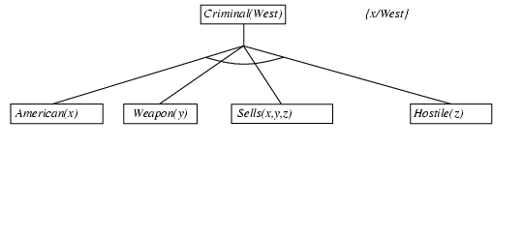
Backward chaining example
1. American(x) ∧ Weapon(y) ∧ Sells(x,y,z) ∧ Hostile(z) ⇒ Criminal(x)
2. Owns(Nono,M1) and Missile(M1)
3. Missile(x) ∧ Owns(Nono,x) ⇒ Sells(West,x,Nono)
4. Missile(x) ⇒ Weapon(x)
5. Enemy(x,America) ⇒ Hostile(x)
6. American(West)
7. Enemy(Nono,America)
Notes:
‹#›

Slide 90
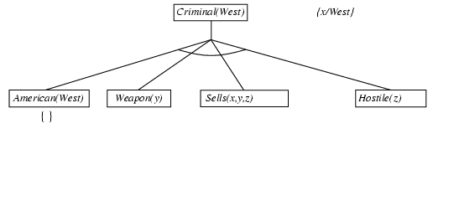
Backward chaining example
1. American(x) ∧ Weapon(y) ∧ Sells(x,y,z) ∧ Hostile(z) ⇒ Criminal(x)
2. Owns(Nono,M1) and Missile(M1)
3. Missile(x) ∧ Owns(Nono,x) ⇒ Sells(West,x,Nono)
4. Missile(x) ⇒ Weapon(x)
5. Enemy(x,America) ⇒ Hostile(x)
6. American(West)
7. Enemy(Nono,America)
Notes:
‹#›

Slide 91
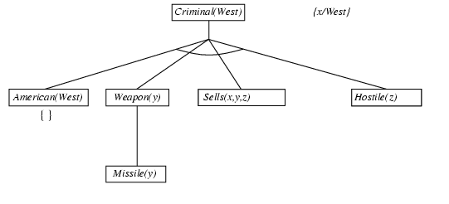
Backward chaining example
1. American(x) ∧ Weapon(y) ∧ Sells(x,y,z) ∧ Hostile(z) ⇒ Criminal(x)
2. Owns(Nono,M1) and Missile(M1)
3. Missile(x) ∧ Owns(Nono,x) ⇒ Sells(West,x,Nono)
4. Missile(x) ⇒ Weapon(x)
5. Enemy(x,America) ⇒ Hostile(x)
6. American(West)
7. Enemy(Nono,America)
Notes:
‹#›

Slide 92
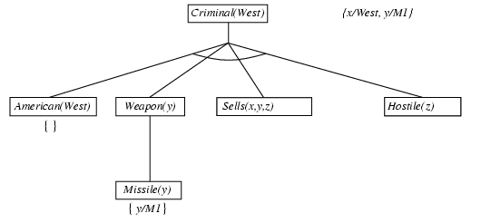
Backward chaining example
1. American(x) ∧ Weapon(y) ∧ Sells(x,y,z) ∧ Hostile(z) ⇒ Criminal(x)
2. Owns(Nono,M1) and Missile(M1)
3. Missile(x) ∧ Owns(Nono,x) ⇒ Sells(West,x,Nono)
4. Missile(x) ⇒ Weapon(x)
5. Enemy(x,America) ⇒ Hostile(x)
6. American(West)
7. Enemy(Nono,America)
Notes:
‹#›

Slide 93
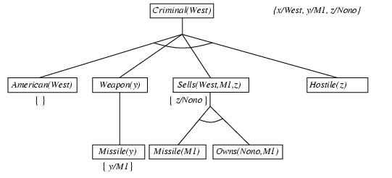
Backward chaining example
1. American(x) ∧ Weapon(y) ∧ Sells(x,y,z) ∧ Hostile(z) ⇒ Criminal(x)
2. Owns(Nono,M1) and Missile(M1)
3. Missile(x) ∧ Owns(Nono,x) ⇒ Sells(West,x,Nono)
4. Missile(x) ⇒ Weapon(x)
5. Enemy(x,America) ⇒ Hostile(x)
6. American(West)
7. Enemy(Nono,America)
Notes:
‹#›

Slide 94
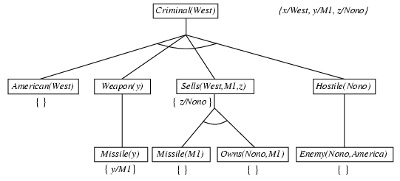
Backward chaining example
1. American(x) ∧ Weapon(y) ∧ Sells(x,y,z) ∧ Hostile(z) ⇒ Criminal(x)
2. Owns(Nono,M1) and Missile(M1)
3. Missile(x) ∧ Owns(Nono,x) ⇒ Sells(West,x,Nono)
4. Missile(x) ⇒ Weapon(x)
5. Enemy(x,America) ⇒ Hostile(x)
6. American(West)
7. Enemy(Nono,America)
Notes:
‹#›

Slide 95
Backward chaining example
1. American(x) ∧ Weapon(y) ∧ Sells(x,y,z) ∧ Hostile(z) ⇒ Criminal(x)
2. Owns(Nono,M1) and Missile(M1)
3. Missile(x) ∧ Owns(Nono,x) ⇒ Sells(West,x,Nono)
4. Missile(x) ⇒ Weapon(x)
5. Enemy(x,America) ⇒ Hostile(x)
6. American(West)
7. Enemy(Nono,America)
Notes:
‹#›

Slide 96
Forward vs. backward chaining
FC is data-driven, automatic, unconscious processing,
e.g., object recognition, routine decisions
May do lots of work that is irrelevant to the goal
BC is goal-driven, appropriate for problem-solving,
e.g., Where are my keys? How do I get into a PhD program?
Complexity of BC can be much less than linear in size of KB
Notes:
‹#›

Slide 97
Conversion to CNF
Eliminate biconditionals and implications
a ⇒ b ≡ ¬ a ∨ b
2. Reduce the scope of each ¬ to a single term.
¬(¬p) ≡ p
deMorgan’s Law
¬ (a ∧ b ) ≡ ¬ a ∨ ¬ b
¬ (a ∨ b ) ≡ ¬ a ∧ ¬ b
Move ¬ inwards:
¬∀x p ≡ ∃x ¬p,
¬ ∃x p ≡ ∀x ¬p
Notes:
‹#›

Slide 98
Conversion to CNF
Standardize variables: each quantifier should use a different variable
∀x :P(x) ∨ ∀x : Q(x) ≡ ∀x :P(x) ∨ ∀y :Q(y)
4. Move all quantifiers to the left of the formula.
∀x :P(x) ∨ ∀y :Q(y) ≡ ∀x ∀y P(x) ∨ Q(y)
5. Eliminate existential instantiation.
6. Drop prefix (universal quantifiers):
∀x ∀y P(x) ∨ Q(y) ≡ P(x) ∨ Q(y)
Notes:
‹#›

Slide 99
Conversion to CNF
7. Convert matrix into a conjunction of disjoints i.e. Apply associative property.
a ∧ (b ∧ c ) ≡ (a ∧ b ) ∧ c
8. Create separate clause corresponding to each conjunct.
(a ∨ b ) ∧ (a ∨ c ) ∧ (d ∨ e ) ∧ (d ∨ f ) ≡
(a ∨ b )
(a ∨ c )
(d ∨ e )
(d ∨ f )
9. Standardize the variables in the set of clausegenerated in step 8.
∀x :P(x) ∨ Q(x) ≡ ∀x : P(x) ∨ ∀x : Q(x)
Notes:
‹#›

Slide 100
Conversion to CNF
Everyone who loves all animals is loved by someone:
∀x [∀y Animal(y) ⇒ Loves(x,y)] ⇒ [∃y Loves(y,x)]
1. Eliminate biconditionals and implications
∀x [¬ ∀y ¬animal(y) ∨ loves(x,y)] ∨ ∃y loves(y,x) - implication elimination
2. Move ¬ inwards: ¬∀x p ≡ ∃x ¬p, ¬ ∃x p ≡ ∀x ¬p
∀x [∃y ¬(¬Animal(y) ∨ Loves(x,y))] ∨ [∃y Loves(y,x)]
∀x [∃y ¬¬Animal(y) ∧ ¬Loves(x,y)] ∨ [∃y Loves(y,x)]
∀x [∃y Animal(y) ∧ ¬Loves(x,y)] ∨ [∃y Loves(y,x)]
Notes:
‹#›

Slide 101
Conversion to CNF contd.
Standardize variables: each quantifier should use a different one
∀x [∃y Animal(y) ∧ ¬Loves(x,y)] ∨ [∃z Loves(z,x)]
4. Skolemize: a more general form of existential instantiation.
Each existential variable is replaced by a Skolem function of the enclosing universally quantified variables:
∀x [Animal(F(x)) ∧ ¬Loves(x,F(x))] ∨ Loves(G(x),x)
Drop universal quantifiers
[Animal(F(x)) ∧ ¬Loves(x,F(x))] ∨ Loves(G(x),x)
Distribute ∨ over ∧ :
[Animal(F(x)) ∨ Loves(G(x),x)] ∧ [¬Loves(x,F(x)) ∨ Loves(G(x),x)]
Notes:
‹#›

Slide 102
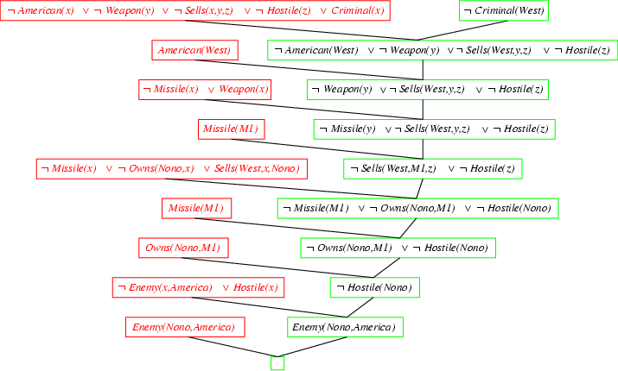
Resolution proof: definite clauses
Notes:
‹#›

Slide 103
Resolution proof: definite clauses
Notes:
‹#›

Slide 104
Resolution example
‹#›
Notes:
‹#›
‹#›

Slide 105
Practice example Did Curiosity kill the cat
Jack owns a dog. Every dog owner is an animal lover. No animal lover kills an animal. Either Jack or Curiosity killed the cat, who is named Tuna. Did Curiosity kill the cat?
These can be represented as follows:
A. (∃x) Dog(x) ∧ Owns(Jack,x)
B. (∀x) ((∃y) Dog(y) ∧ Owns(x, y)) → AnimalLover(x)
C. (∀x) AnimalLover(x) → ((∀y) Animal(y) → ¬Kills(x,y))
D. Kills(Jack,Tuna) ∨ Kills(Curiosity,Tuna)
E. Cat(Tuna)
F. (∀x) Cat(x) → Animal(x)
G. Kills(Curiosity, Tuna)
GOAL
‹#›
Notes:
‹#›
‹#›

Slide 106
Convert to clause form
A1. (Dog(D))
A2. (Owns(Jack,D))
B. (¬Dog(y), ¬Owns(x, y), AnimalLover(x))
C. (¬AnimalLover(a), ¬Animal(b), ¬Kills(a,b))
D. (Kills(Jack,Tuna), Kills(Curiosity,Tuna))
E. Cat(Tuna)
F. (¬Cat(z), Animal(z))
Add the negation of query:
¬G: (¬Kills(Curiosity, Tuna))
D is a skolem constant
‹#›
Notes:
‹#›
‹#›

Slide 107
The resolution refutation proof
A1. (Dog(D))
A2. (Owns(Jack,D))
B. (¬Dog(y), ¬Owns(x, y), AnimalLover(x))
C. (¬AnimalLover(a), ¬Animal(b), ¬Kills(a,b))
D. (Kills(Jack,Tuna), Kills(Curiosity,Tuna))
E. Cat(Tuna)
F. (¬Cat(z), Animal(z))
Add the negation of query:
¬G: (¬Kills(Curiosity, Tuna))
R1: ¬G, D, {} (Kills(Jack, Tuna))
R2: R1, C, {a/Jack, b/Tuna} (~AnimalLover(Jack), ~Animal(Tuna))
R3: R2, B, {x/Jack} (~Dog(y), ~Owns(Jack, y), ~Animal(Tuna))
R4: R3, A1, {y/D} (~Owns(Jack, D), ~Animal(Tuna))
R5: R4, A2, {} (~Animal(Tuna))
R6: R5, F, {z/Tuna} (~Cat(Tuna))
R7: R6, E, {} FALSE
‹#›
Notes:
‹#›
‹#›

Slide 108
The proof tree
¬G
D
{}
R1: K(J,T)
C
{a/J,b/T}
R2: ¬AL(J) ∨ ¬A(T)
B
{x/J}
R3: ¬D(y) ∨ ¬O(J,y) ∨ ¬A(T)
A1
{y/D}
R4: ¬O(J,D), ¬A(T)
A2
{}
R5: ¬A(T)
F
{z/T}
R6: ¬C(T)
E
{}
‹#›
R7: FALSE
Notes:
‹#›
‹#›

Slide 109
Translate this sentence into first order predicate logic:
“An elephant is happy if all its children can fly”
Use these predicates:
happy(x) is read as “x is happy”
fly(x) is read as “x can fly”
child(x,y) is read as “x is a child of y”
elephant(x) is read as “x is an elephant”
OR
‹#›
Notes:
‹#›

Slide 110
“The rainfall in every Latin American country is at least 17cm a year”
Asha Bharambe
‹#›
Notes:
‹#›

Slide 111
1a) Translate the following sentences into first order logic.
(i) All dogs are mammals
(ii) Fido is a dog
(iii) Fido is a mammal
(iv) All mammals produce milk
1b) Use the Modus Ponens deduction rule to deduce sentence (iii) from (i) and (ii). What did you
unify in order to use Modus Ponens, and what substitution made the unification possible?
Asha Bharambe
‹#›
Notes:
‹#›

Slide 112
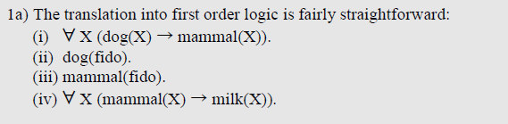
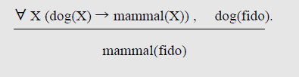
Asha Bharambe
‹#›
Notes:
‹#›

Slide 113
Automating FOL inference with resolution
‹#›
Notes:
‹#›
‹#›

Slide 114
Resolution
Resolution is a sound and complete inference procedure for FOL
Reminder: Resolution rule for propositional logic:
P₁ ∨ P₂ ∨ ... ∨ P_{n}
¬P₁ ∨ Q₂ ∨ ... ∨ Q_{m}
Resolvent: P₂ ∨ ... ∨ P_{n} ∨ Q₂ ∨ ... ∨ Q_{m}
Examples
P and ¬ P ∨ Q : derive Q (Modus Ponens)
(¬ P ∨ Q) and (¬ Q ∨ R) : derive ¬ P ∨ R
P and ¬ P : derive False [contradiction!]
‹#›
Notes:
‹#›
‹#›

Slide 115
Resolution refutation
Given a consistent set of axioms KB and goal sentence Q, show that KB |= Q
Proof by contradiction: Add ¬Q to KB and try to prove false.
i.e., (KB |- Q) ↔ (KB ∨ ¬Q |- False)
Resolution is refutation complete: it can establish that a given sentence Q is entailed by KB, but can’t (in general) be used to generate all logical consequences of a set of sentences
Also, it cannot be used to prove that Q is not entailed by KB.
Resolution won’t always give an answer since entailment is only semidecidable
And you can’t just run two proofs in parallel, one trying to prove Q and the other trying to prove ¬Q, since KB might not entail either one
‹#›
Notes:
‹#›
‹#›

Slide 116
Converting to CNF
‹#›
Notes:
‹#›
‹#›

Slide 117
Converting sentences to CNF
1. Eliminate all ↔ connectives
(P ↔ Q) ⇒ ((P → Q) ^ (Q → P))
2. Eliminate all → connectives
(P → Q) ⇒ (¬P ∨ Q)
3. Reduce the scope of each negation symbol to a single predicate
¬¬P ⇒ P
¬(P ∨ Q) ⇒ ¬P ∧ ¬Q
¬(P ∧ Q) ⇒ ¬P ∨ ¬Q
¬(∀x)P ⇒ (∃x)¬P
¬(∃x)P ⇒ (∀x)¬P
4. Standardize variables: rename all variables so that each quantifier has its own unique variable name
‹#›
Notes:
‹#›
‹#›

Slide 118
Converting sentences to clausal form Skolem constants and functions
5. Eliminate existential quantification by introducing Skolem constants/functions
(∃x)P(x) ⇒ P(c)
c is a Skolem constant (a brand-new constant symbol that is not used in any other sentence)
(∀x)(∃y)P(x,y) ⇒ (∀x)P(x, f(x))
since ∃ is within the scope of a universally quantified variable, use a Skolem function f to construct a new value that depends on the universally quantified variable
f must be a brand-new function name not occurring in any other sentence in the KB.
E.g., (∀x)(∃y)loves(x,y) ⇒ (∀x)loves(x,f(x))
In this case, f(x) specifies the person that x loves
‹#›
Notes:
‹#›
‹#›

Slide 119
Converting sentences to clausal form
6. Remove universal quantifiers by (1) moving them all to the left end; (2) making the scope of each the entire sentence; and (3) dropping the “prefix” part
Ex: (∀x)P(x) ⇒ P(x)
7. Put into conjunctive normal form (conjunction of disjunctions) using distributive and associative laws
(P ∧ Q) ∨ R ⇒ (P ∨ R) ∧ (Q ∨ R)
(P ∨ Q) ∨ R ⇒ (P ∨ Q ∨ R)
8. Split conjuncts into separate clauses
9. Standardize variables so each clause contains only variable names that do not occur in any other clause
‹#›
Notes:
‹#›
‹#›

Slide 120
An example
(∀x)(P(x) → ((∀y)(P(y) → P(f(x,y))) ∧ ¬(∀y)(Q(x,y) → P(y))))
2. Eliminate →
(∀x)(¬P(x) ∨ ((∀y)(¬P(y) ∨ P(f(x,y))) ∧ ¬(∀y)(¬Q(x,y) ∨ P(y))))
3. Reduce scope of negation
(∀x)(¬P(x) ∨ ((∀y)(¬P(y) ∨ P(f(x,y))) ∧(∃y)(Q(x,y) ∧ ¬P(y))))
4. Standardize variables
(∀x)(¬P(x) ∨ ((∀y)(¬P(y) ∨ P(f(x,y))) ∧(∃z)(Q(x,z) ∧ ¬P(z))))
5. Eliminate existential quantification
(∀x)(¬P(x) ∨((∀y)(¬P(y) ∨ P(f(x,y))) ∧(Q(x,g(x)) ∧ ¬P(g(x)))))
6. Drop universal quantification symbols
(¬P(x) ∨ ((¬P(y) ∨ P(f(x,y))) ∧(Q(x,g(x)) ∧ ¬P(g(x)))))
‹#›
Notes:
‹#›
‹#›

Slide 121
Example
7. Convert to conjunction of disjunctions
(¬P(x) ∨ ¬P(y) ∨ P(f(x,y))) ∧ (¬P(x) ∨ Q(x,g(x))) ∧
(¬P(x) ∨ ¬P(g(x)))
8. Create separate clauses
¬P(x) ∨ ¬P(y) ∨ P(f(x,y))
¬P(x) ∨ Q(x,g(x))
¬P(x) ∨ ¬P(g(x))
9. Standardize variables
¬P(x) ∨ ¬P(y) ∨ P(f(x,y))
¬P(z) ∨ Q(z,g(z))
¬P(w) ∨ ¬P(g(w))
‹#›
Notes:
‹#›
‹#›

